Slide 1
College Code -7125
Name:N.Muthulingaselvi
Register number:712521104025
Data warehousing with IBM cloud Db2 warehouse

Slide 2
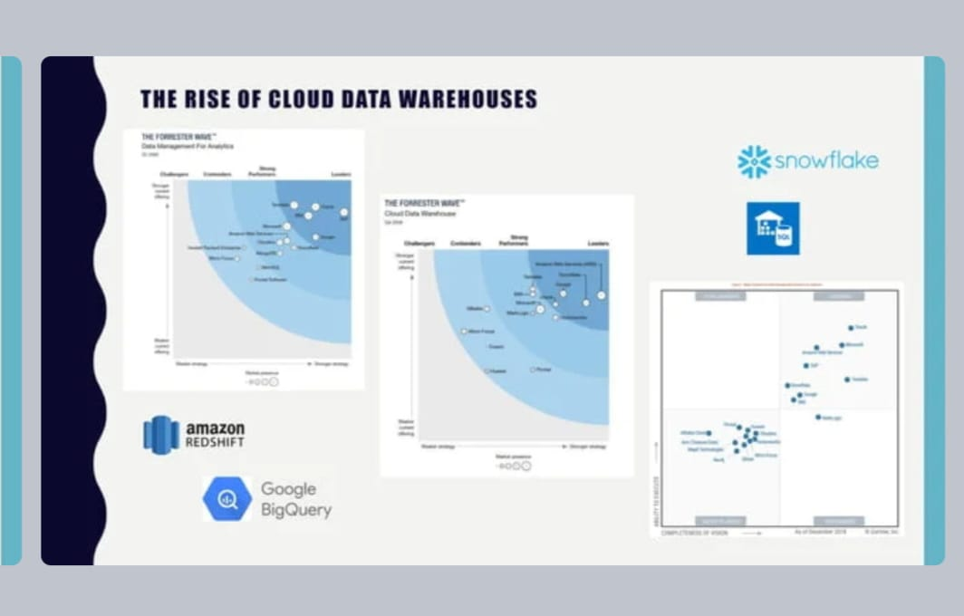

Slide 3
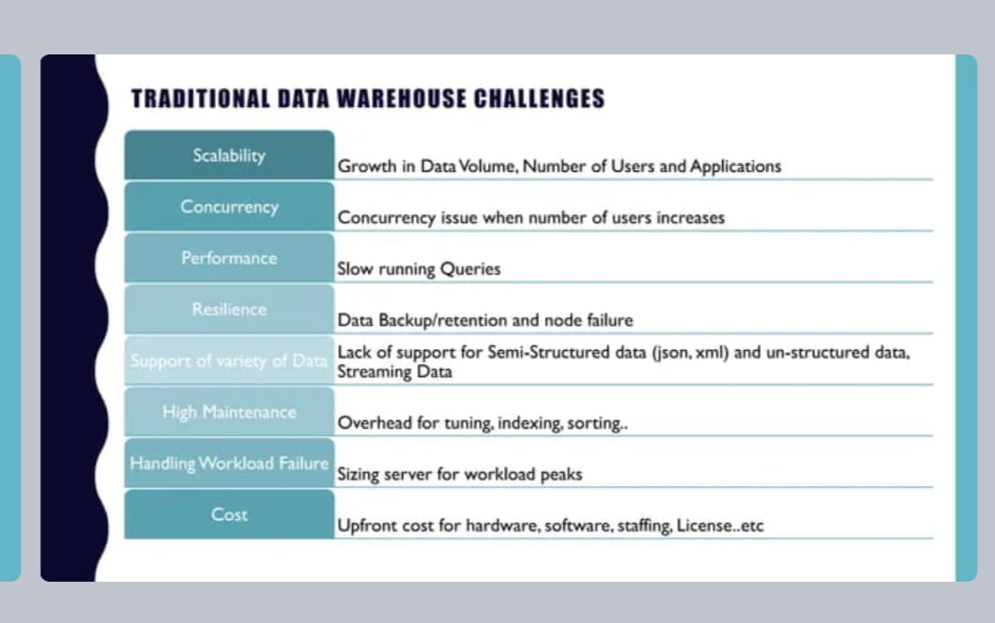

Slide 4
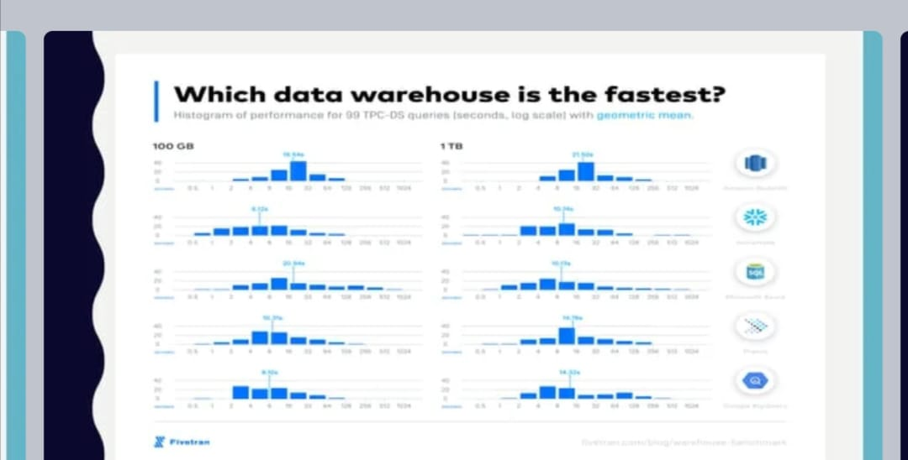

Slide 5
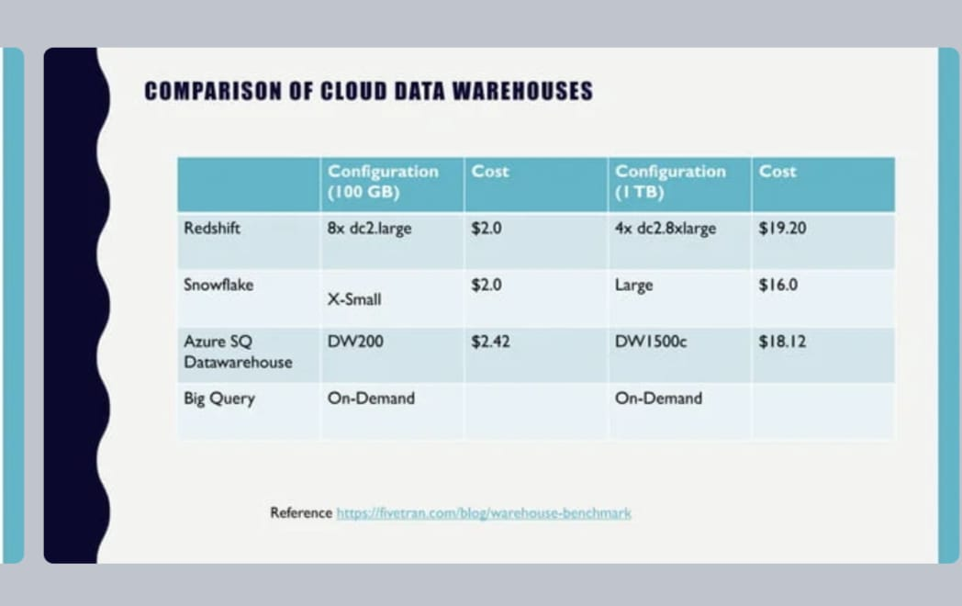

Slide 6
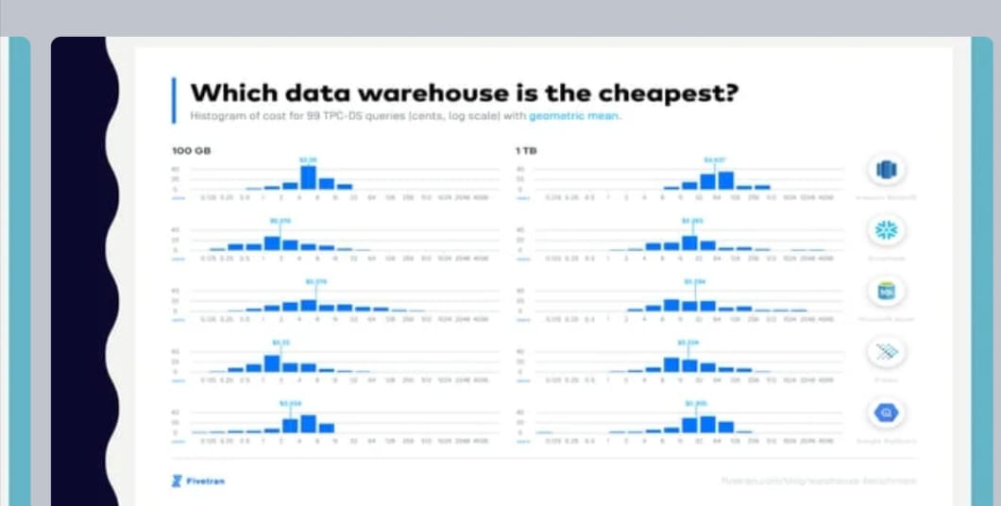

Slide 7
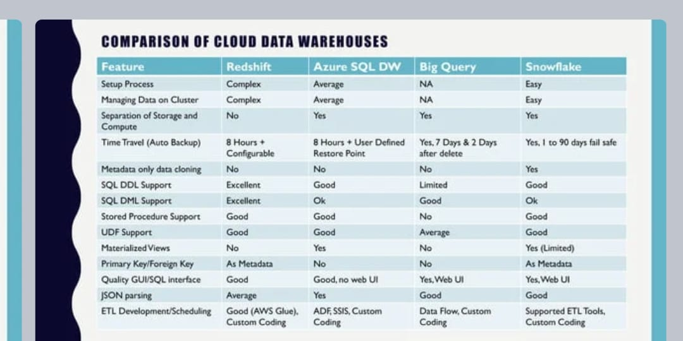

Slide 8
